Slide 1
Truck&Trailer Trajectory Generation via Reinforcement Learning

Slide 2
Introduction on Reinforcement Learning

Slide 3
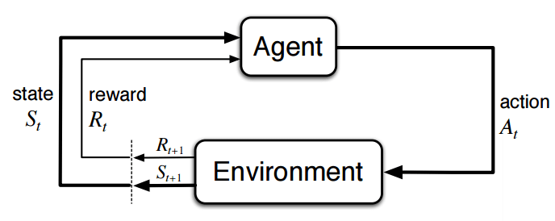

Slide 4
Basic reinforcement learning is modeled as a Markov decision process (MDP)
a set of environment and agent states, S
a set of actions, A, of the agent
P_{a}( s, s’) is the probability of transition state s to state s’ under action a
R_{a}( s, s') is the immediate reward after transition from
s to s' with action a.

Slide 5
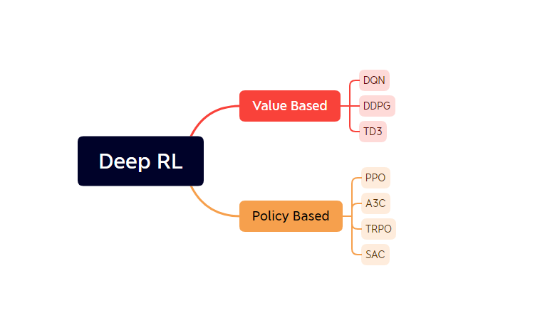
Classification of Deep reinforcement learning

Slide 6
Background of Truck Trailer Control

Slide 7
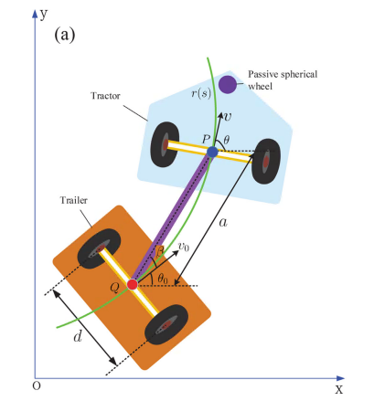
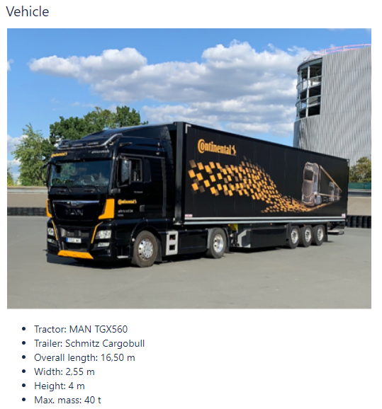

Slide 8
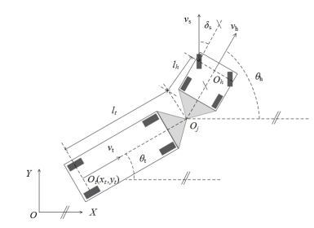
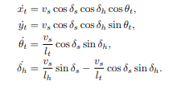
TT Kinematics

Slide 9
Content and Target of My Work
Develop Training environment for the agent
Design constraint on the training environment
Design proper reward function for the agent to fulfill the task
Finish the article on RL based Truck&Trailer trajectory generation

Slide 10
Experiments on Continuous Lane

Slide 11
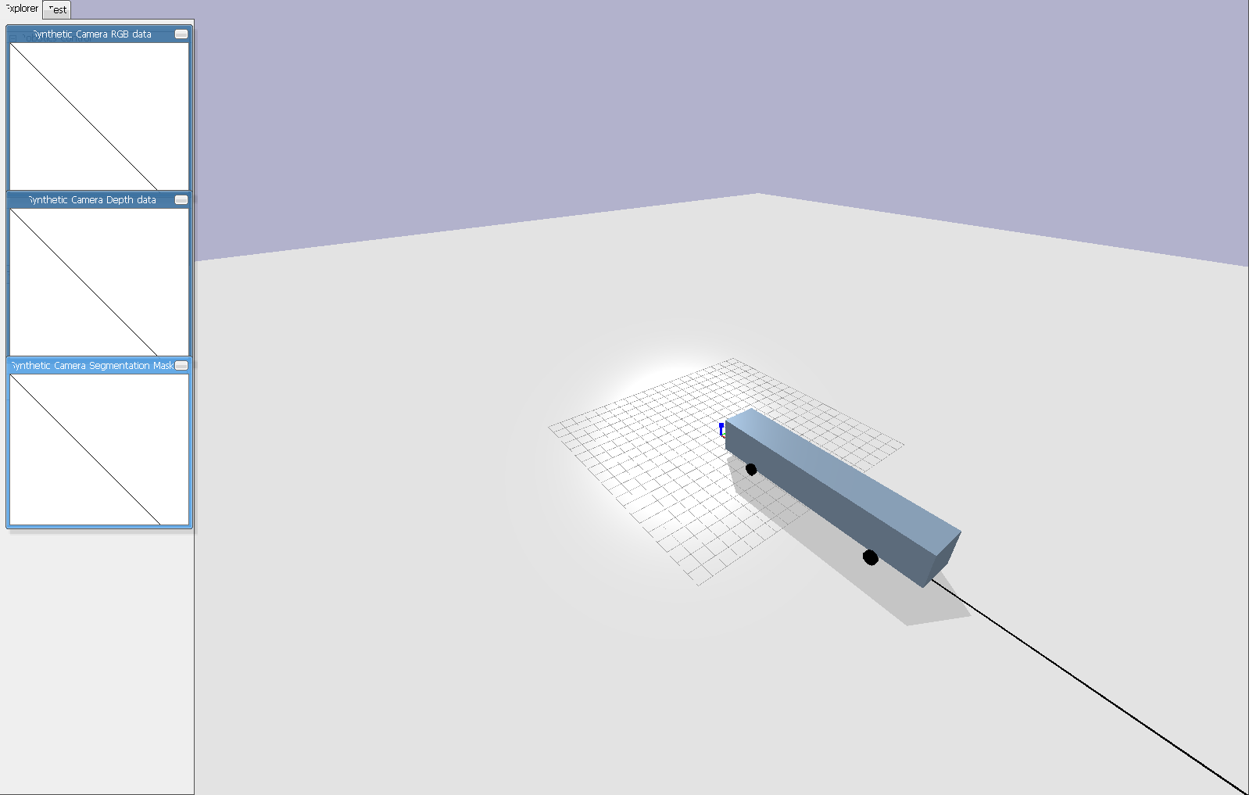
Initially we want to train the agent to follow a straight line and reach a target 200 meters away from the starting point. In the simulation world, we use the black line to serve as a reference line and use the bus model for training. The visualization of the environment v1 is shown below

Slide 12

Experiment Setting: Same State Space

Slide 13
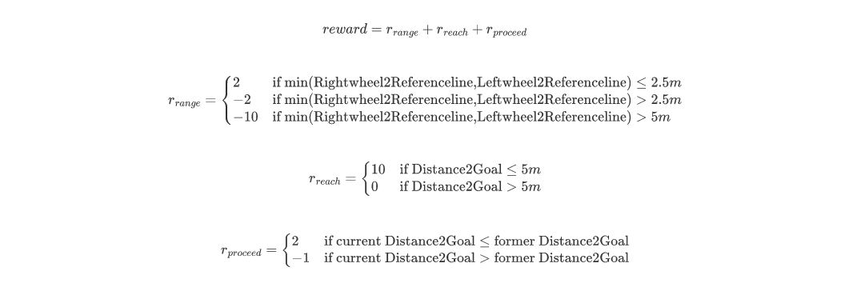
Experiments on Reward V1

Slide 14
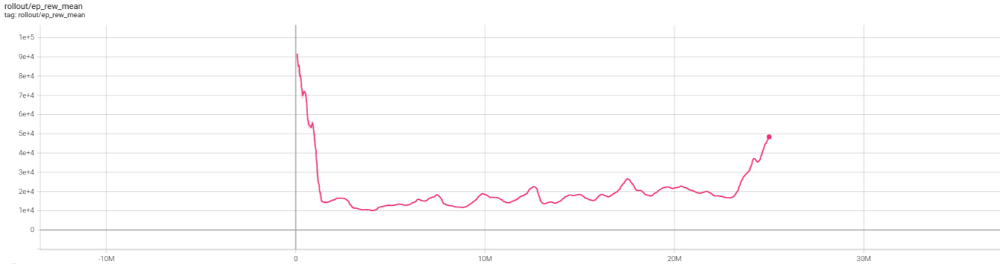
Results of Reward V1

Slide 15
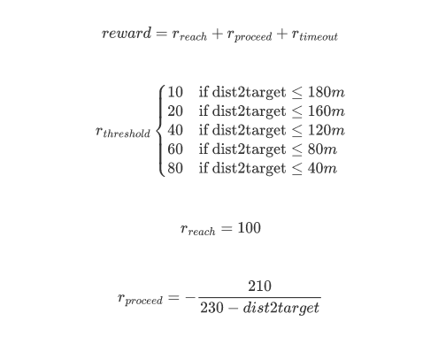
Experiments on Reward V2

Slide 16
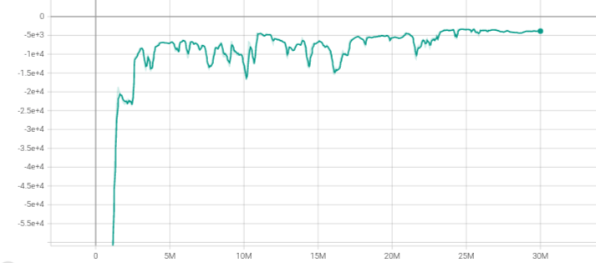
Results of Reward V2

Slide 17
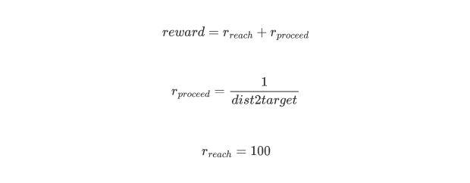
Experiments on reward V3

Slide 18
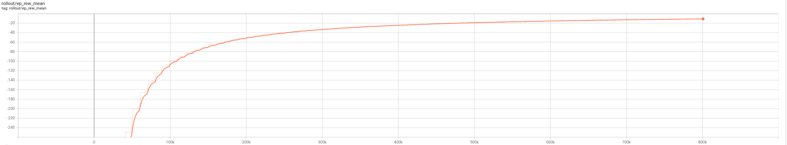
Results of Reward V3
ILD - Goal_Reaching for Bus Model - All Documents (sharepoint.com)

Slide 19
Conclusion
After checking the animation, we found that the agent can follow the reference line for some time and move forward, but still end up deviating from it. It makes us to think whether it is a good way to craft the issue like that. After discussion about that, we decide to change the environment, using a series of discrete way point to represent the reference path which is easily to shift its shape and the length of it can be infinite.

Slide 20
Experiments on Discretized Lane

Slide 21
Goal Reaching Task on Bus Model

Slide 22
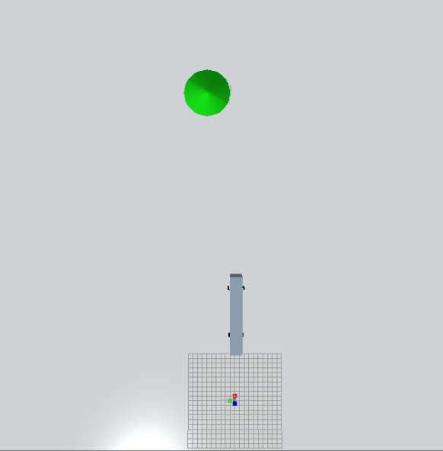
In this environment, we stick with the bus model and the target is shown in green in the simulation environment. To make the policy learning by reinforcement learning more robust, the goal will be generated randomly in a certain range: 50 to 100 meters in X-axis and -60 to 60 meters in Y-axis.

Slide 23
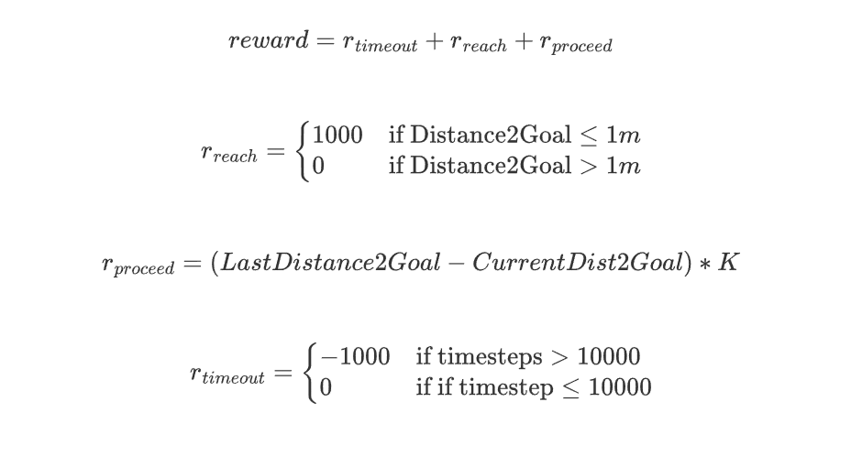
Experiment Setting : Same Reward function

Slide 24
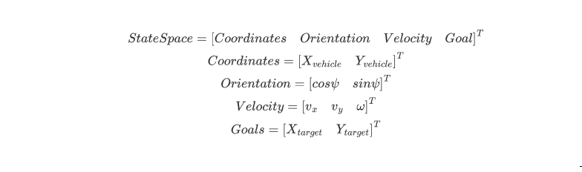
World Coordination Experiments

Slide 25
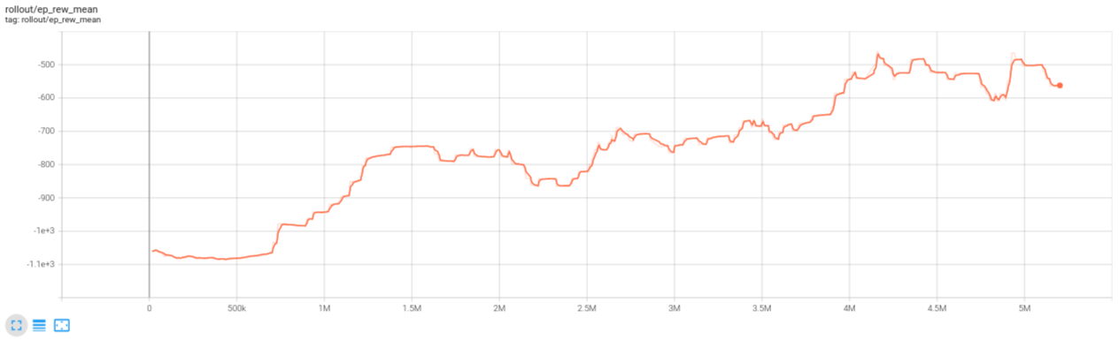
Training Results
ILD - State V1 - All Documents (sharepoint.com)

Slide 26
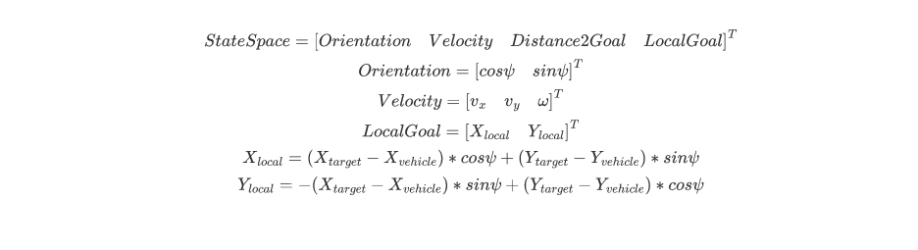
Local Coordination Experiments

Slide 27
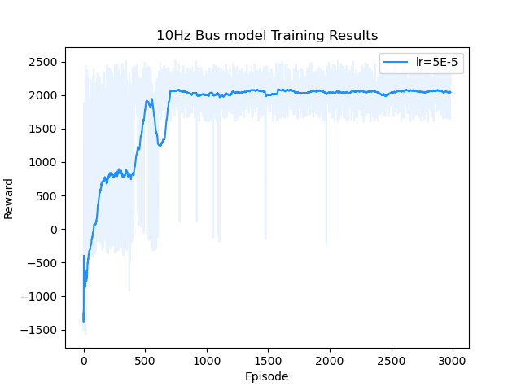
Training Results
ILD - video_lr=5E-5.mp4 - All Documents (sharepoint.com)

Slide 28
Conclusion
In this goal reaching environment, we suffer a lot from wrong observation space, unreasonable k setting and high learning rate. They all contribute to our previous failure. Luckily, we manage to solve them all step by step, and have a practical experience with tuning the parameter of reinforcement leaning environment. Goal reaching environment is only an intermediate stage for our project. Since we have succeeded in solving it, we can move forward to the track environment

Slide 29
Way points following task

Slide 30
Fixed Map Tracking Task on Bus Model

Slide 31
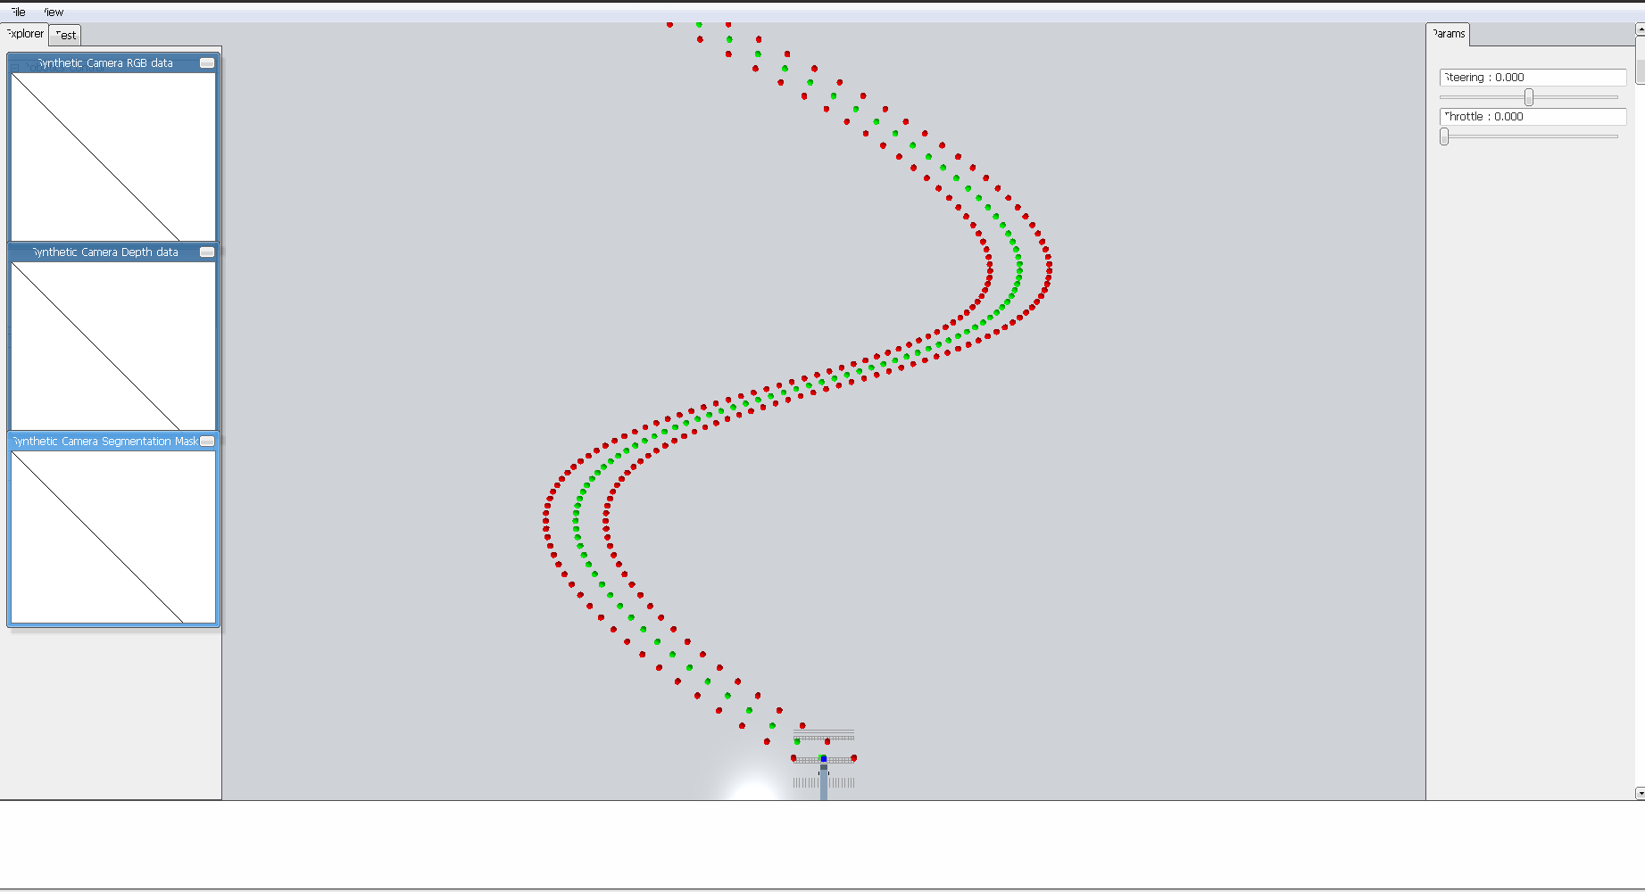
After getting satisfactory results from the last environment, we can move to the track scenarios which are more challenging than the previous one. Also, finishing the task needs the experience from the former experiment. In this scenario, the reference line is discretized and represented by green waypoints, the edges of the lane are represented by red points. The lane is formulated by the B-spline equation. Control points and other parameters are shown below, along with the visualization of the whole track.

Slide 32
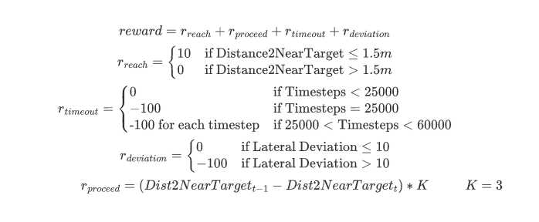
Experiment Setting

Slide 33
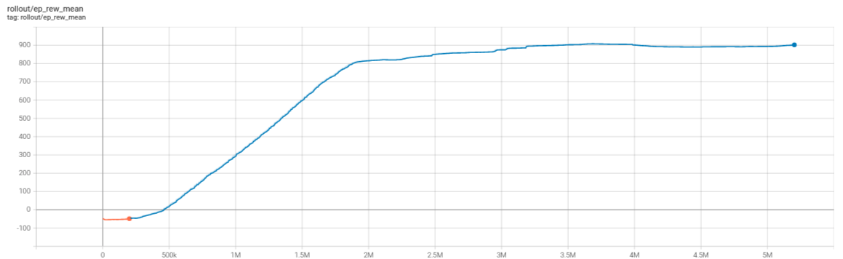
Experiment Results
1207video.mp4 (sharepoint.com)

Slide 34
Variant Map Tracking Task on Bus Model

Slide 35
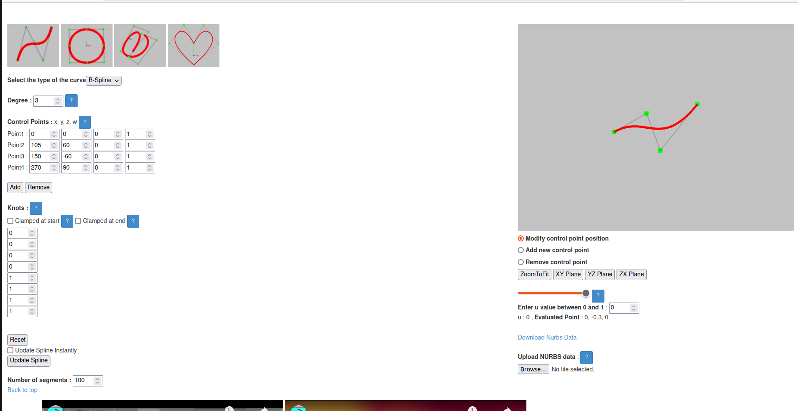
Map Generation
map_generation.mp4 (sharepoint.com)

Slide 36
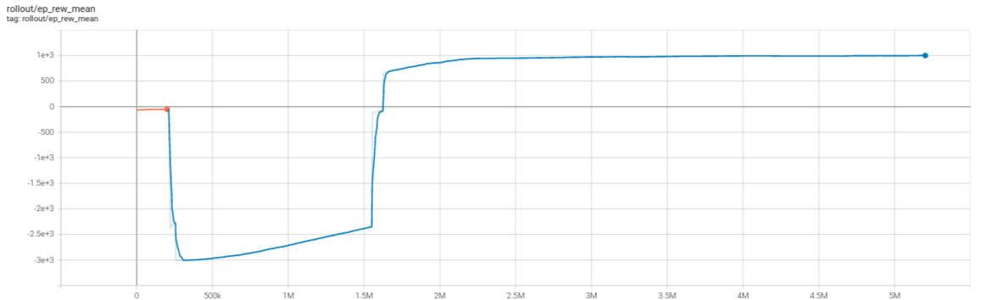
Training Results
random5_0110.mp4 (sharepoint.com)

Slide 37
Conclusion
Since we can train the bus model to follow the randomly generated reference path without off-tracking, we can shift our attention from bus model to a more complex kinematics, which is the Truck Trailer system, and we will directly apply the truck trailer control in random map environment

Slide 38
Variant Map Tracking Task on Truck&Trailer model

Slide 39
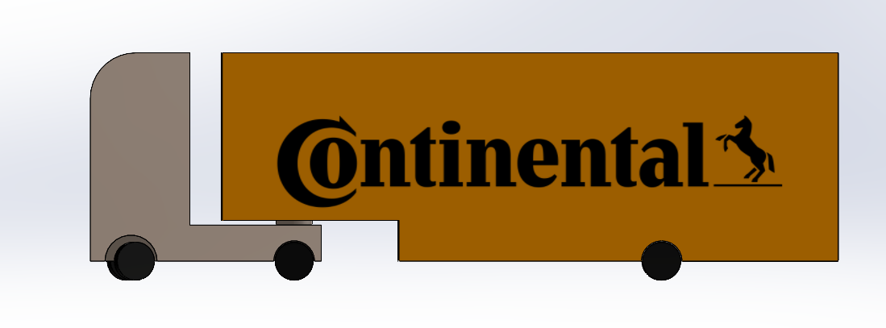
3D model of Truck Trailer
Truck&Trailer.mp4 (sharepoint.com)
Truck_Trailer_demo.mp4 (sharepoint.com)

Slide 40
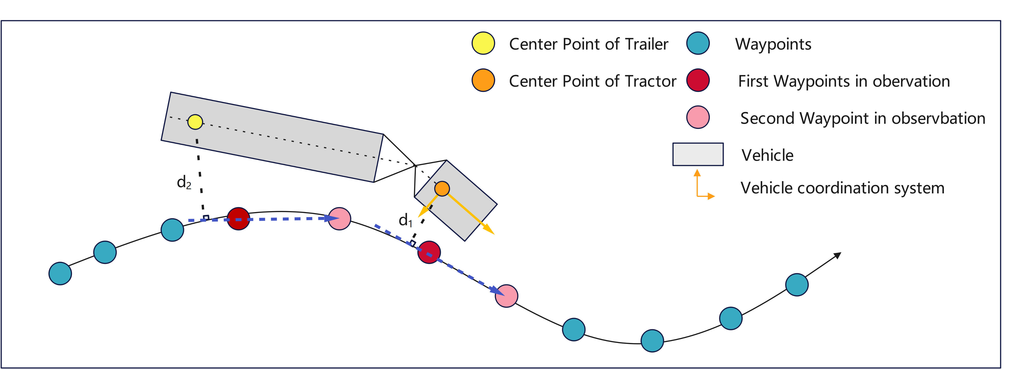

Deviation Definition of Truck Trailer
sparse.mp4 (sharepoint.com)

Slide 41
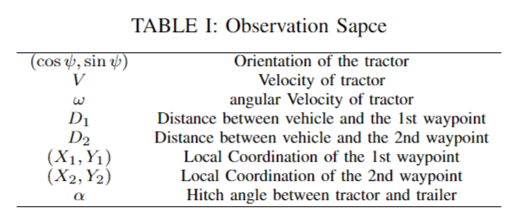
Observation Space of Truck Trailer

Slide 42
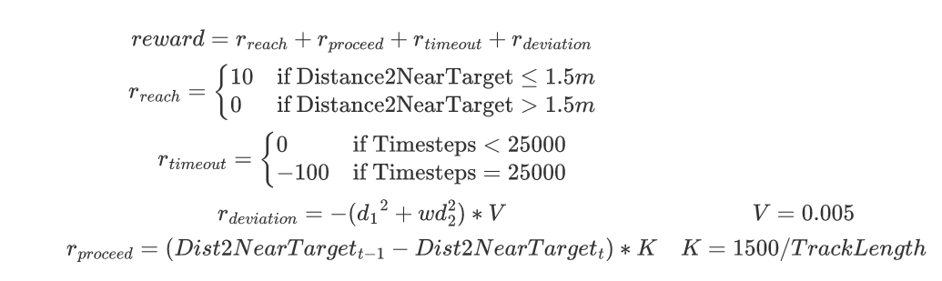
Reward Function of Truck Trailer
0410_success.mp4 (sharepoint.com)

Slide 43
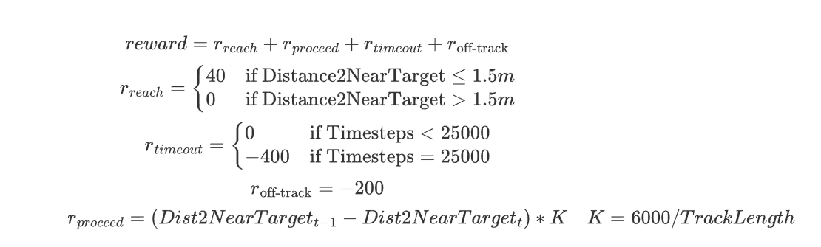
Reward Function of Truck Trailer

Slide 44
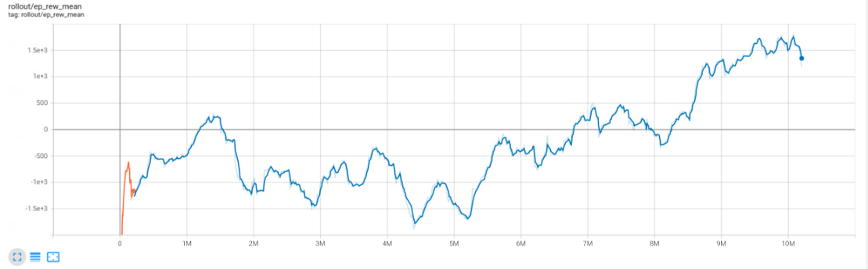

Slide 45
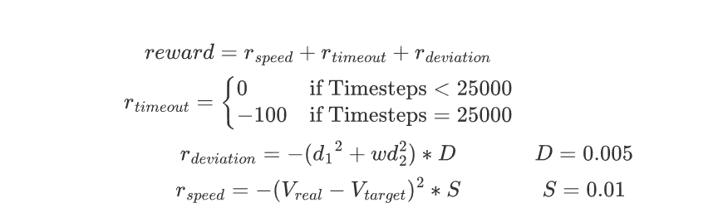
Reward Function of Truck Trailer v2

Slide 46
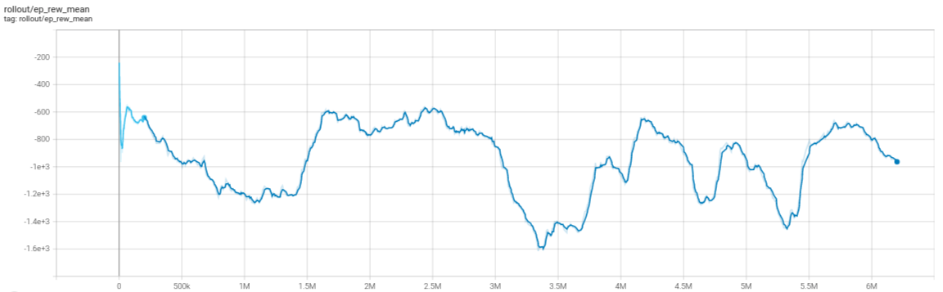
Training Results of Reward V2
0424_20waypointsahead.mp4 (sharepoint.com)

Slide 47
Future work

Slide 48
Keep Fine tuning the hyperparamter of the reward function for Truck Trailer
Finish up the conference paper

Slide 49
Thank You

